Slide 1





E-VOTING SYSTEM
AJMEER
SHADOO-BUCCUS
IITI
ADVISOR: SUBHRA MAZUMDAR
17/03/2025

Slide 2


Introduction to E-Voting System
1
What is E-Voting?
An electronic voting system (e-voting) allows voters to cast ballots through digital means, improving accessibility, efficiency, and security compared to traditional paper voting.
2
Importance of E-Voting
E-voting enhances accessibility, efficiency, and security, increasing voter participation and reducing costs. It streamlines the election process, ensuring faster, more accurate results while preventing fraud.
3
Questions & Hypothesis
Q: How can e-voting systems be designed to ensure both voter privacy and election security?
H: Voter trust in e-voting systems increases with the implementation of transparent security measures, such as blockchain.

Slide 3



Key Study and Findings
India has used Electronic Voting Machines (EVMs) since 2001, praised for reducing fraud and improving reliability compared to paper ballots. While concerns about tampering persist, public trust remains high due to audits and Voter Verified Paper Audit Trails (VVPAT). EVMs also reduce election costs by eliminating paper ballots and manual counting.
Theoretical Framework
The theoretical framework of e-voting combines key concepts such as the Technology Acceptance Model (TAM), which focuses on ease of use and usefulness, and the Diffusion of Innovations theory, explaining how e-voting spreads over time. It also incorporates Public Key Infrastructure (PKI) for secure voting, Trust and Transparency to build voter confidence, and Risk Management to address security concerns. Together, these theories help explain how e-voting is adopted, its security, and public trust.
Literature Review
Implementation of Blockchain
Key gaps in e-voting literature include insufficient research on real-world security vulnerabilities, long-term public trust, and scalability in developing countries. The impact of the digital divide on voter access, effective post-election auditing, user experience for non-tech-savvy voters, and legal/ethical concerns like privacy and data protection also remain underexplored. These areas require further investigation to improve e-voting systems.

Slide 4




Research Objectives
Main Research Objective
The main research objective of e-voting based on security and privacy is to develop electronic voting systems that ensure security, privacy, and integrity. This involves protecting the system against cyberattacks, ensuring voter anonymity and confidentiality, and preventing fraud or manipulation of votes. Additionally, the system should allow for transparent verification of votes without compromising privacy, ensure fault tolerance in case of errors or attacks, and comply with legal standards. The goal is to create a trustworthy e-voting system that upholds both voter privacy and election integrity.
Specific Goals
To ensure privacy and security in e-voting, key goals include implementing strong data encryption to protect vote confidentiality, ensuring voter anonymity while maintaining vote integrity, and employing secure authentication methods. The system must guarantee the integrity of votes using cryptographic techniques, provide auditability and transparency for verification, and protect against cyberattacks through robust security measures. Additionally, secure vote transmission and fault tolerance are essential to maintain system availability and reliability, fostering trust in the electoral process.
Expected Outcomes
The expected outcomes of enhancing privacy and security in e-voting systems include ensuring confidentiality and anonymity for voters, maintaining the integrity of votes, and preventing fraud or tampering. The system will provide transparent verification mechanisms for both voters and auditors, while safeguarding against cyberattacks and technical failures. Ultimately, these improvements will foster greater trust in the e-voting process, ensuring that elections are both secure and privacy-respecting, leading to fair and reliable election outcomes.

Slide 5






Methodology
Research Design
Data Collection Method
Sample Size & Participants
Data Analysis & Techniques
E-voting research typically involves a diverse group of voters to assess trust and privacy, alongside cybersecurity experts and election officials to evaluate system security and operational concerns. The sample size can range from hundreds to thousands for surveys and experiments, while interviews and focus groups usually involve smaller, targeted groups for in-depth insights.
Data collection methods for e-voting research include surveys to assess user opinions on security and trust, interviews with experts to explore system concerns, and experiments or simulations to test performance and security. Additionally, case studies and focus groups provide insights into real-world system effectiveness and user experience.
Data analysis techniques in e-voting research include statistical analysis for evaluating security and performance, thematic analysis for identifying patterns in user feedback, and comparative analysis to compare systems across contexts. Simulation-based analysis is also used to test system behavior under various conditions.
E-voting research uses a mixed-methods approach, combining quantitative analysis of security and system performance with qualitative methods like interviews to understand user trust and privacy concerns, offering a comprehensive evaluation of both technical and user experience aspects.

Slide 6
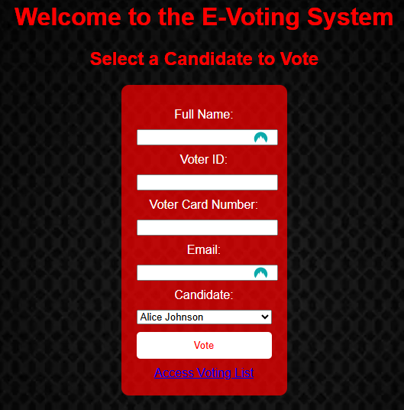

Project Overview
The evoting.py application is a web-based voting system built using Flask. It allows users to cast votes for candidates securely and sends confirmation emails to voters. The application uses encryption to protect the votes and provides a simple interface for both voting and managing configuration settings. It also converts the voters’ credentials into a token number for privacy purpose and sends an automatic e-mail to the voters to confirm their votes.
https://10.17.5.10:443/
https://10.17.5.10:443/vote

Slide 7

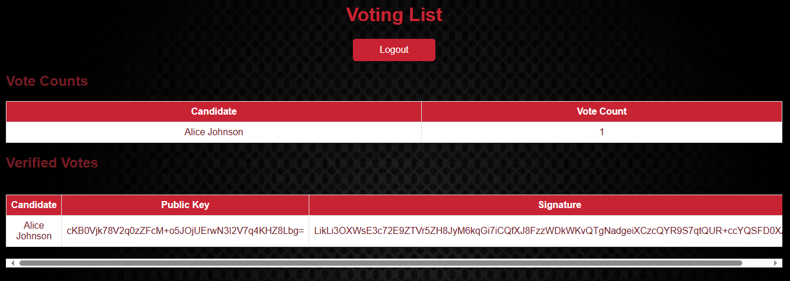
Project Overview
https://10.17.5.10:443/login
https://10.17.5.10:443/voting_list

Slide 8
2. Email Notifications: Integrates EmailJS to send confirmation emails to voters after they cast their votes.
4. In-Memory Storage: Stores votes in a list for demonstration purposes, allowing easy retrieval and display.
KEY FEATURES
Framework: Utilizes Flask to create a web application with routing and templating capabilities.
3. Vote Encryption: Uses the cryptography library's Fernet symmetric encryption to securely encrypt votes before storing them.
5. Login Page to confirm authorised access to voting list page

Slide 9
SOLUTIONS
SECURITY
The system integrates multiple security mechanisms to prevent tampering and unauthorized access:
Public Key Cryptography (NaCl/TweetNaCl) is utilized to encrypt votes, ensuring secure data transmission.
SHA-256 hashing is implemented to anonymize voter identities and prevent duplicate voting.
Session-based authentication safeguards access to administrative functionalities.
SSL encryption is enforced to protect data exchange over the network.
TECHNOLOGY
Programming Language: Python
Web Framework: Flask
Database: SQLite
Security Libraries: PyNaCl, hashlib
Data Processing: Pandas
SYSTEM REQUIREMENTS AND DEPENDENCIES
The system requires the following files:
evoting.exe (Standalone executable for Windows users)
evoting.py (Main Python script for development and debugging)
candidates.csv (List of candidates participating in the election)
voters_list_updated.csv (Database of registered voters)
cert.pem & key.pem (SSL certificates to enable secure HTTPS connections)
EmailJS.txt (Configuration file for email notifications)
To install dependencies, execute:
pip install Flask Flask-SQLAlchemy pandas pynacl emailjs

Slide 10
FINDINGS
SECURITY
Votes are encrypted and digitally signed, preventing unauthorized modifications.
Voter anonymity is ensured through SHA-256 hashing.
Multi-voting attempts are blocked, maintaining election integrity.
PERFORMANCE
The system operates with low computational overhead, ensuring smooth execution.
Vote tallying occurs in real time, enhancing administrative efficiency.
The admin panel remains restricted, accessible only through proper authentication credentials.
USER EXPERIENCE
The interface is intuitive, allowing easy navigation for voters and administrators.
Installation and execution are straightforward, particularly with the standalone executable.
Error handling and feedback mechanisms provide users with clear guidance in case of incorrect inputs.

Slide 11
ANALYSIS
RISK ASSESSMENT
Voter Authentication Risks:
Threats: People who are not authorized to vote casting fraudulent votes.
Mitigation: Public key cryptography and digital signatures are implemented.
Data Tampering:
Threats: Vote data can be altered without encryption.
Mitigation: SHA-256 hashing, end to end encryption and database integrity checks.
Insider Threats:
Threats: Distortion of election outcomes by way of malicious insiders.
Mitigation: Audit logs, strict admin access controls, and real time monitoring are used.
Cybersecurity Attacks
Threats: DDoS attacks, phishing scams, malware injections.
Mitigation: Secure HTTPS connections, firewalls and intrusion detection systems were used.

Slide 12

ANALYSIS
COMPARISON WITH TRADITIONAL VOTING METHODS
Criteria | Digital Voting | Traditional Paper Voting
Security | Uses encryption, authentication, and fraud detection. | Susceptible to ballot tampering and physical loss.
Efficiency | Vote tallying occurs in real time. | Requires manual counting, increasing error potential.
Accessibility | Enables remote voting for people with disabilities or in distant areas. | Requires physical presence at polling stations.
Scalability | Can handle a large number of voters efficiently. | Logistical constraints limit scalability.
Cost | Lower long-term costs after initial setup. | Requires recurring costs for printing, staffing, and logistics.

Slide 13

ANALYSIS
SCALABILITY AND PERFORMANCE EVALUATION
The E-Voting System is currently designed for small to medium-scale elections. However, to facilitate national-level elections, the following enhancements are necessary:
Cloud-Based Infrastructure: Transitioning to cloud-based databases (AWS, Azure, or Google Cloud) would improve storage capacity and processing power.
Load Balancing: Distributing network traffic across multiple servers would prevent overload and downtime during peak voting periods.
Blockchain Integration: Implementing a decentralized ledger would ensure vote integrity by preventing data tampering.
Optimized Database Queries: Indexing and query optimization techniques can reduce response times, improving user experience.

Slide 14


CONCLUSION
The E-Voting System provides a robust, secure, and transparent framework for conducting elections. By integrating public-key cryptography, secure authentication mechanisms, and real-time vote tallying, it ensures electoral integrity and prevents fraud.
While the system is well-suited for organizational and local elections, further enhancements are required to scale it for national and international elections. These improvements include higher computational efficiency, stronger security frameworks, and enhanced accessibility for a broader population.

Slide 15


RECOMMENDATIONS
Blockchain Integration
Using blockchain technology for vote recording would create an immutable and transparent ledger of votes, preventing fraudulent modifications and ensuring verifiability.
Multi-Factor Authentication (MFA)
Introducing two-step verification (e.g., OTPs or biometric authentication) for both voters and administrators would enhance security against unauthorized access.
Mobile App Development
Developing a mobile application for Android and iOS would increase accessibility, allowing voters to participate conveniently from their smartphones while ensuring security through mobile-based encryption.
Cloud-Based Infrastructure
Shifting to a cloud-hosted system would enhance scalability and reduce the risk of server failures. Cloud storage solutions offer real-time backups and disaster recovery options.
Advanced Analytics Dashboard
Integrating AI-powered analytics tools would help administrators monitor voting patterns, detect anomalies, and gain real-time insights into voter engagement.

Slide 16

REFERENCES
References
Flask Documentation: https://flask.palletsprojects.com/
SQLAlchemy Documentation: https://www.sqlalchemy.org/
PyNaCl (Cryptography Library): https://pynacl.readthedocs.io/
Blockchain in Elections Research: https://www.researchgate.net/publication/Blockchain-Elections
Pandas Library: https://pandas.pydata.org/
Cybersecurity in Online Voting: https://www.sciencedirect.com/science/article/online-voting-security

Slide 17


THANK YOU
FOR WATCHING!
https://github.com/aj-king2507/E-voting-System.git

